Slide 1
Real Estate Price Prediction

Slide 2
Problem Statement
The real estate market involves multiple factors such as location, house size, number of bedrooms, and amenities, making property price estimation complex and often inaccurate.
Buyers struggle to determine fair prices, while sellers and investors lack data-driven insights for decision-making.
This project aims to analyze housing data and develop a machine learning model to accurately predict house prices, along with an interactive Power BI dashboard to uncover key market trends and insights.

Slide 3
Dataset Description
The dataset contains detailed information about residential house properties.
It consists of numerical and categorical variables.
In given dataset there is 21613 rows and 21 features.
Most of the features in the dataset are numerical, supported by limited categorical variables.
It includes features related to price, location, size, and house characteristics.
Each record represents a single house sale transaction.

Slide 4
Feature Engineering
Created Total House Area by combining living area and basement area to better represent the overall usable space.
Applied Target Encoding on Zipcode by converting it into average price, enabling the model to understand location impact effectively.
Converted Year Renovated into a binary feature (Renovated: Yes/No) to simplify its influence on price.
Removed highly correlated features (sqft_living15, sqft_lot15) to reduce redundancy and improve model performance.
Created House Age feature using the year built to capture the effect of property age on pricing.
Extracted Sale Year from the date column to make time-based analysis meaningful.

Slide 5
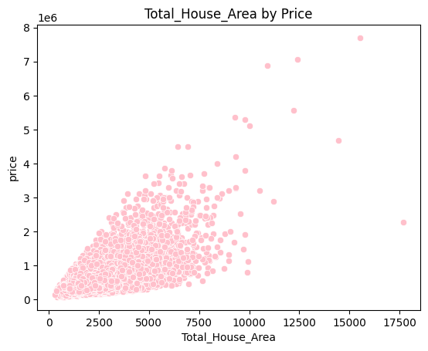
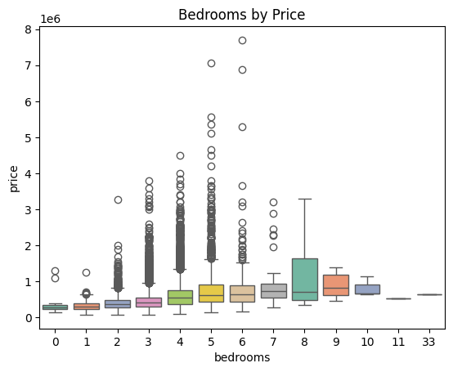
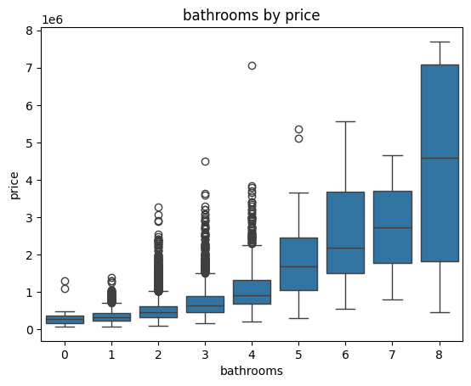
Exploratory Data Analysis
The scatter plot shows a positive relationship between total house area and price, indicating that larger houses generally have higher prices, though there is some variation and outliers.
The chart shows that house prices generally increase with the number of bedrooms, but the relationship is not very strong, with many outliers and overlapping price ranges across different bedrooms
House prices generally increase with the number of bathrooms, especially after 4 bathrooms, indicating higher-value luxury properties.

Slide 6
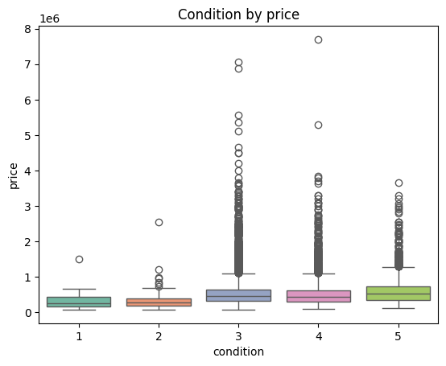
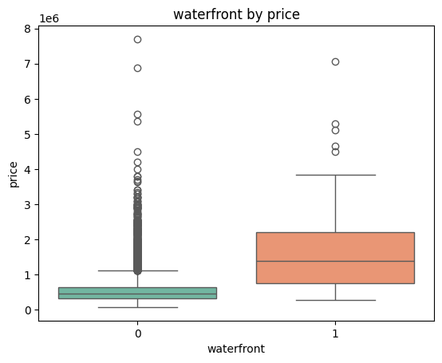
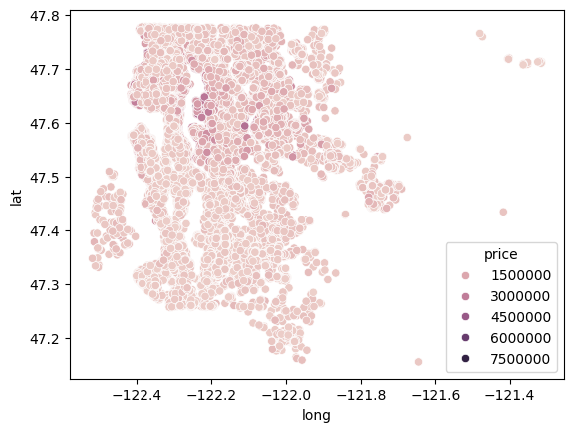
Exploratory Data Analysis
House prices slightly increase with better condition, but the impact is moderate and less significant compared to other factors.
The median price for waterfront homes is much higher.
Waterfront properties also show greater price variation.
Overall, having a waterfront strongly increases house price.
Higher-priced houses are concentrated in specific locations, showing that location (latitude & longitude) strongly influences property prices.

Slide 7
Data Preparation
Removed irrelevant and negatively correlated features (id, Age) to improve model performance.
Defined independent variables (X) and target variable (y) for model training
Split the dataset into training (80%) and testing (20%) sets.
Used a fixed random state (123) to ensure reproducibility of results.

Slide 8
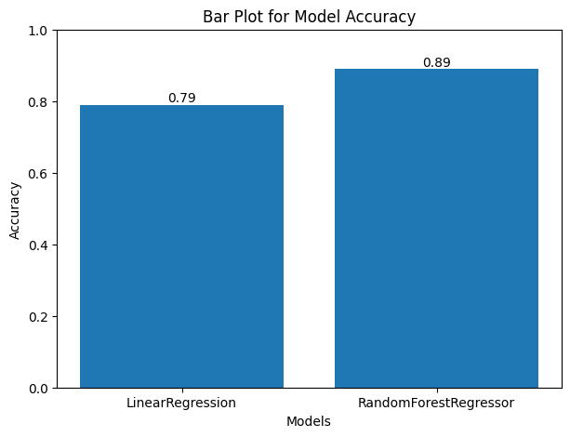
Model Selection
Linear Regression
Simple baseline model (linear relationship)
Random Forest
Handles complex patterns, gives better accuracy

Slide 9
Model Comparison
Model | R² Score | MAE | RMSE
Linear Regression | 79.84 | 100983 | 168708
Random Forest | 89.01 | 69583.99 | 124589.43

Slide 10
Model Evaluation (Random Forest)
Content:R² Score: 0.89 ✅
MAE (Mean Absolute Error): 69,583.99
RMSE (Root Mean Squared Error): 124,589.43
Insight (important line):
👉 The model explains 89% of the variance in house prices, indicating strong predictive performance.

Slide 11
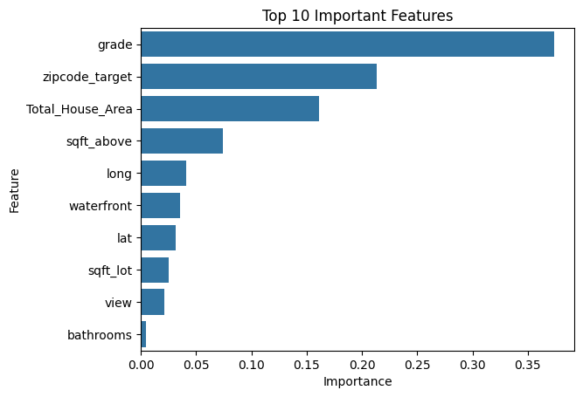
Feature Importance
Grade is the most influential factor
Zipcode (location) plays a major role
Total House Area significantly impacts price
Features like bathrooms & view have lower impact

Slide 12
Conclusion
Random Forest achieved the best performance
Key drivers: Grade, Location, Area
Model can help in:
Property valuation
Investment decisions
Real estate pricing strategy
Business Insights
Houses with higher construction grade have significantly higher prices
Location (zipcode) strongly influences property value
Larger living area increases house price
Waterfront properties add premium value

Slide 13
